Slide 1
Fraction time series

Slide 2
Mixing batch: DS Endmembers: US, Soil, Rain

Slide 3
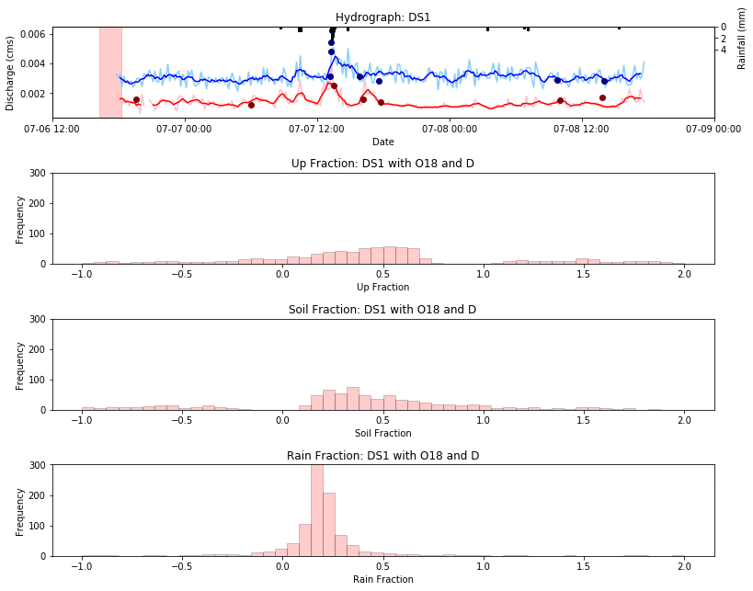
$$δ^{18}O and δD$$

Slide 4
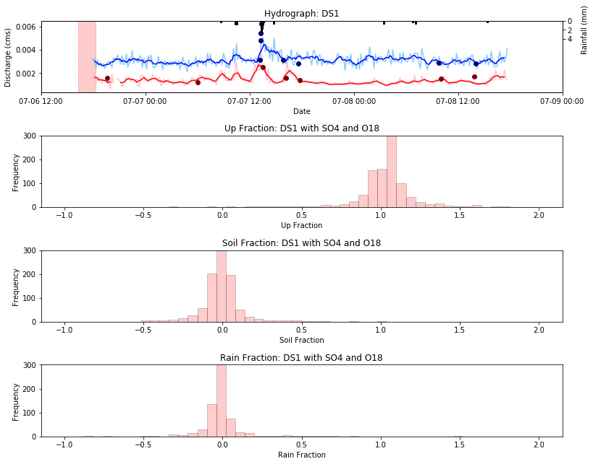
$${SO_{4} and δ}^{18}O$$

Slide 5
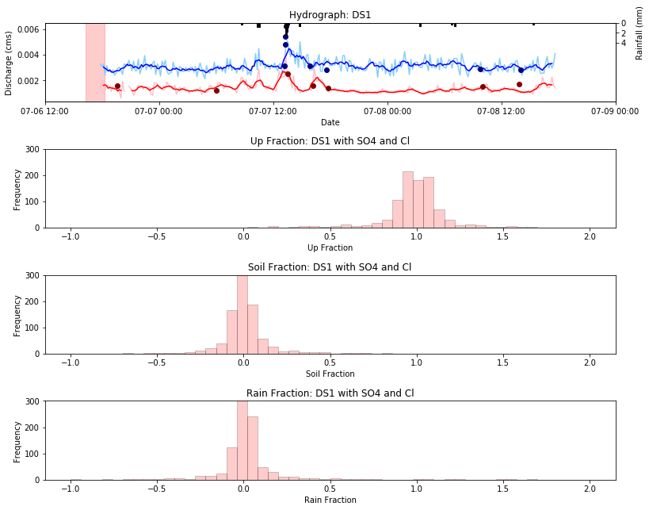
$$SO_{4} and Cl$$

Slide 6
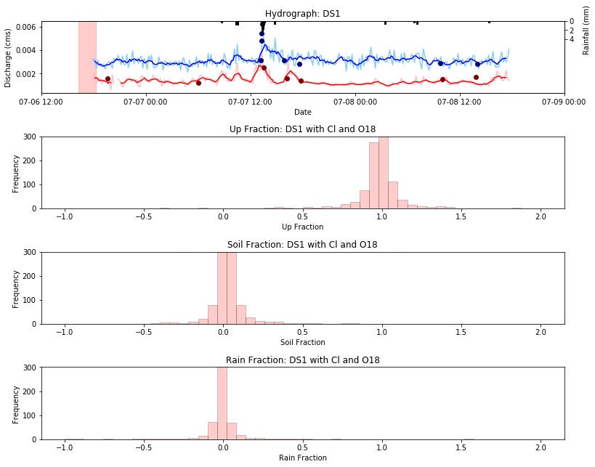
$${Cl and δ}^{18}O$$

Slide 7
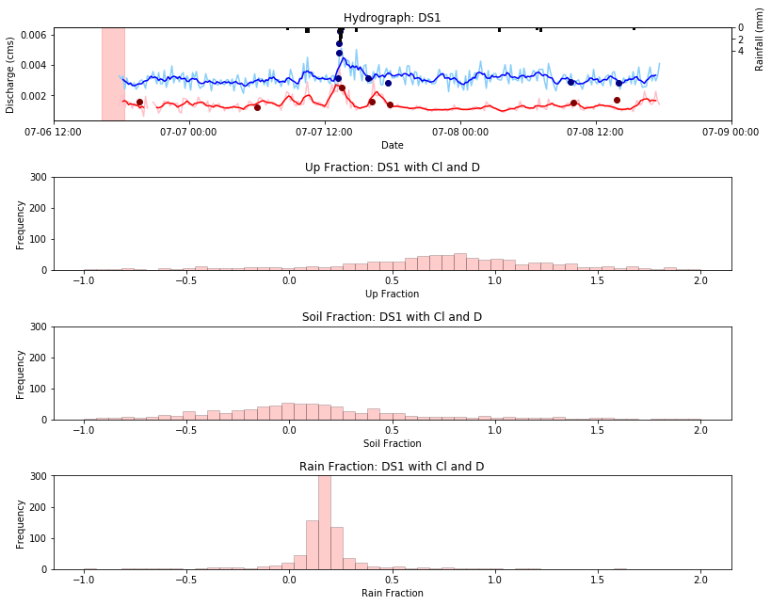
$$Cl and δD$$

Slide 8
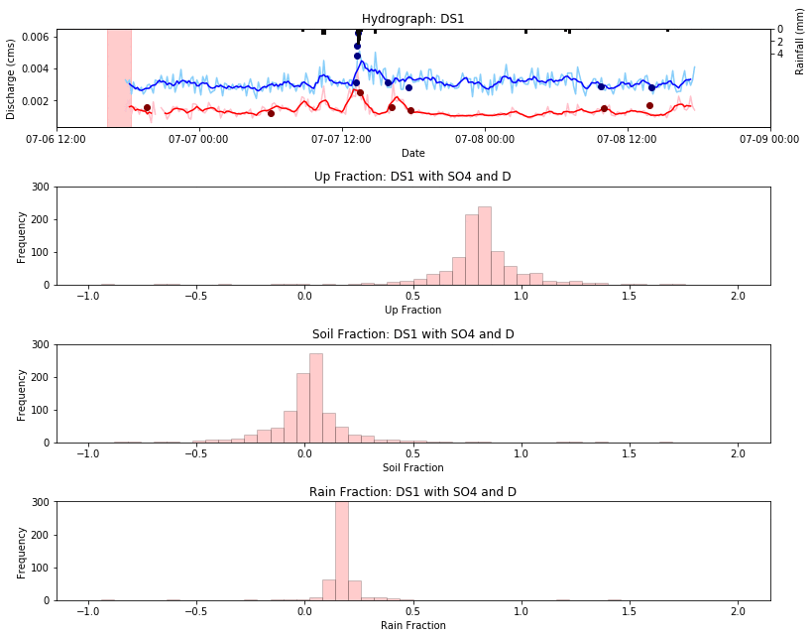
$$SO_{4} and δD$$

Slide 9
Mixing batch: US Endmembers: Spring, Soil, Rain

Slide 10
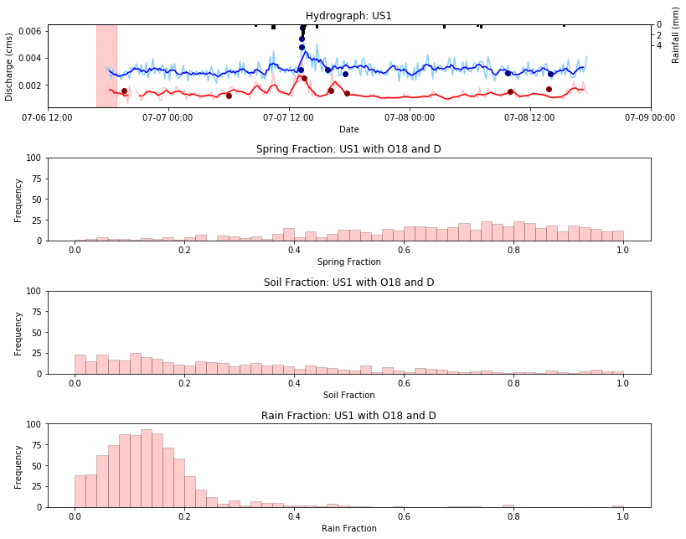
$$δ^{18}O and δD$$

Slide 11
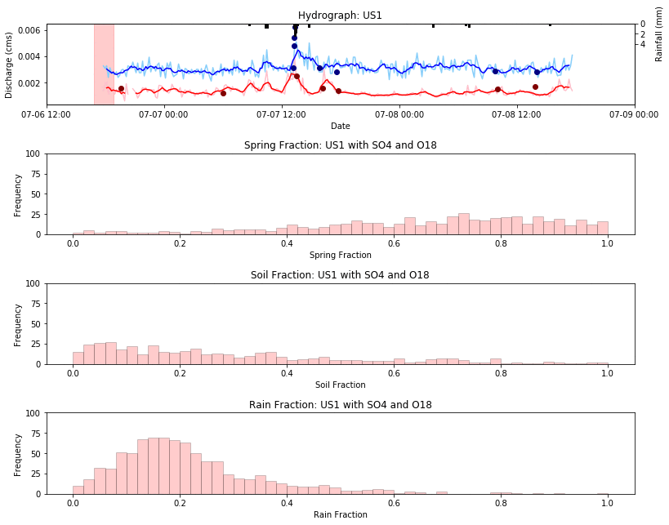
$${SO_{4} and δ}^{18}O$$

Slide 12
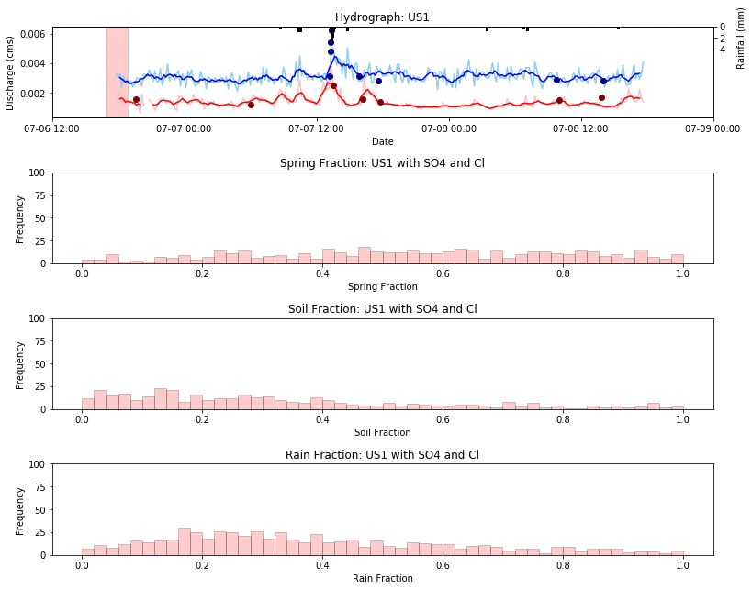
$$SO_{4} and Cl$$

Slide 13
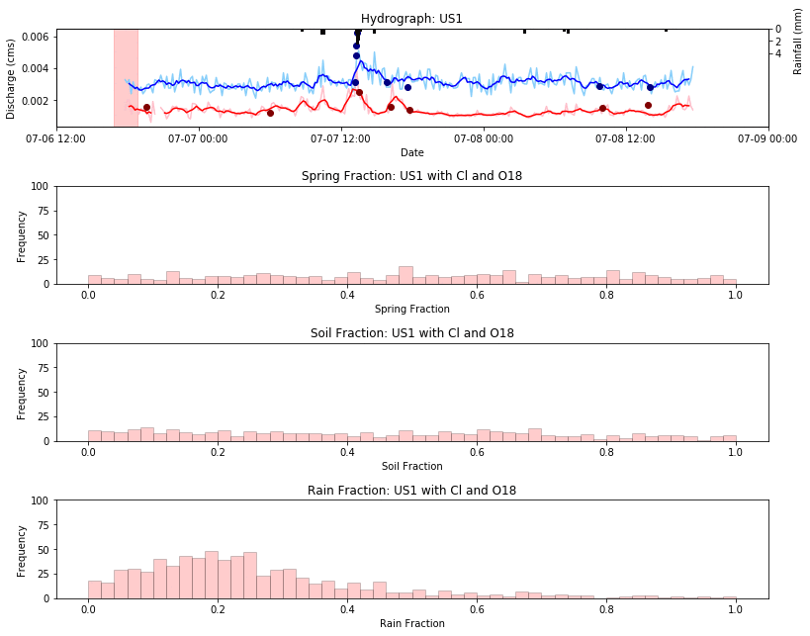
$${Cl and δ}^{18}O$$

Slide 14
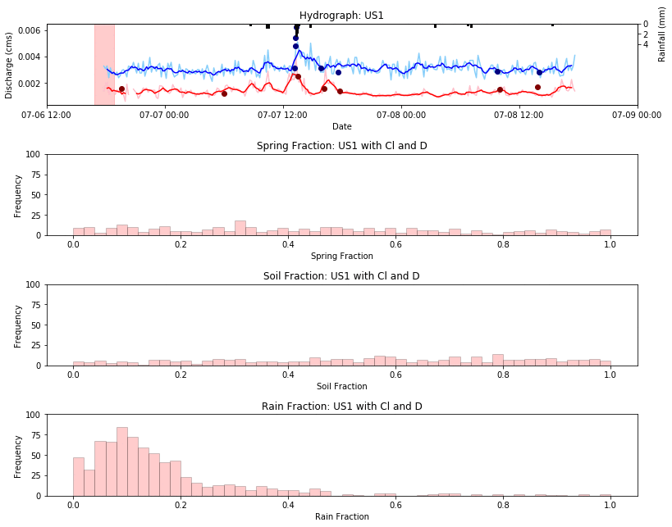
$$Cl and δD$$

Slide 15
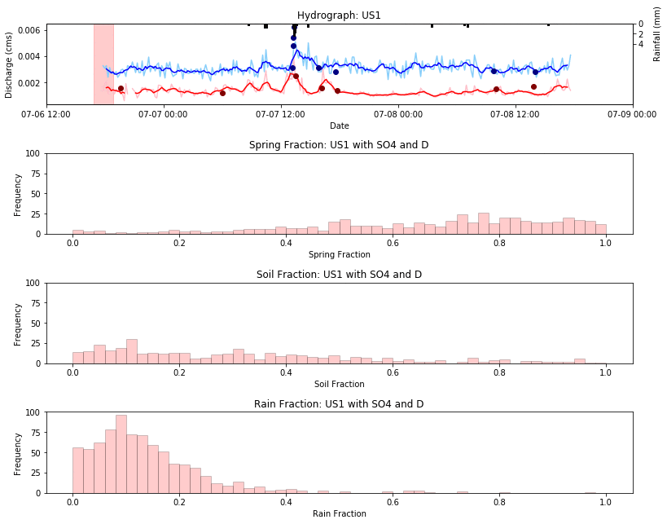
$$SO_{4} and δD$$

